Slide 1

Digital
Staying Healthy
at School
Scrambled Sentences
©www.thecurriculumcorner.com

Slide 2
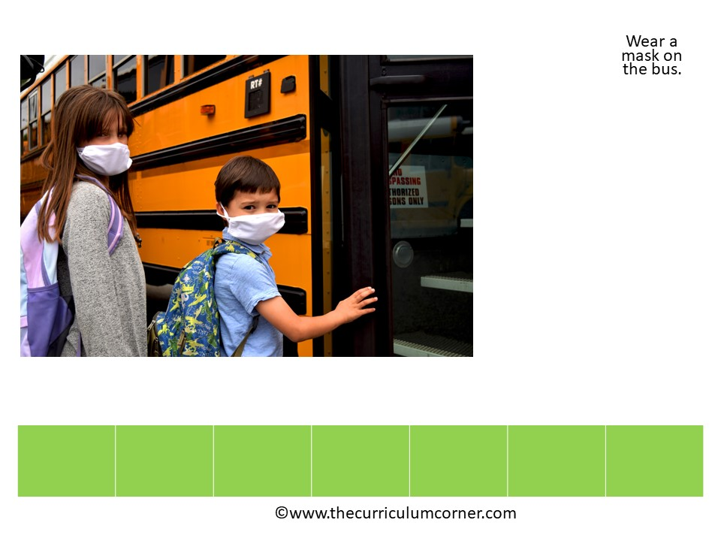

.
mask
the
Wear
bus
a
on

Slide 3

.
Wash
hands
your

Slide 4
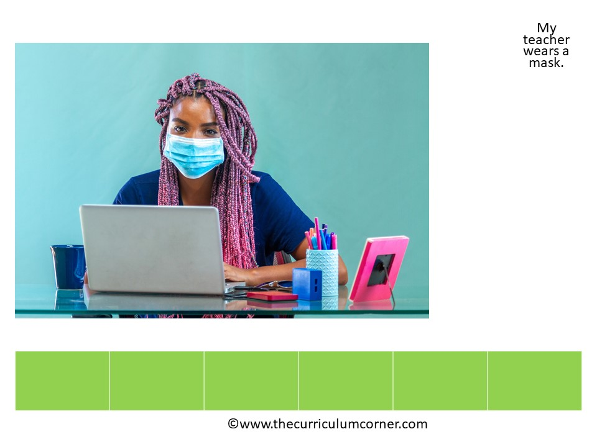
.
My
a
mask
wears
teacher

Slide 5
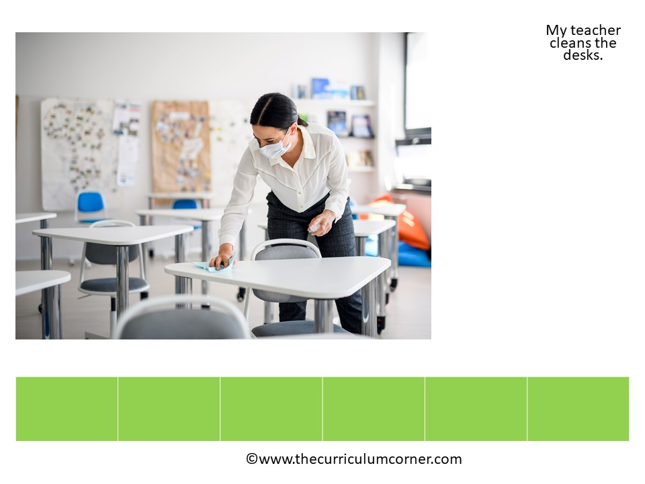
.
teacher
cleans
the
desks
My

Slide 6
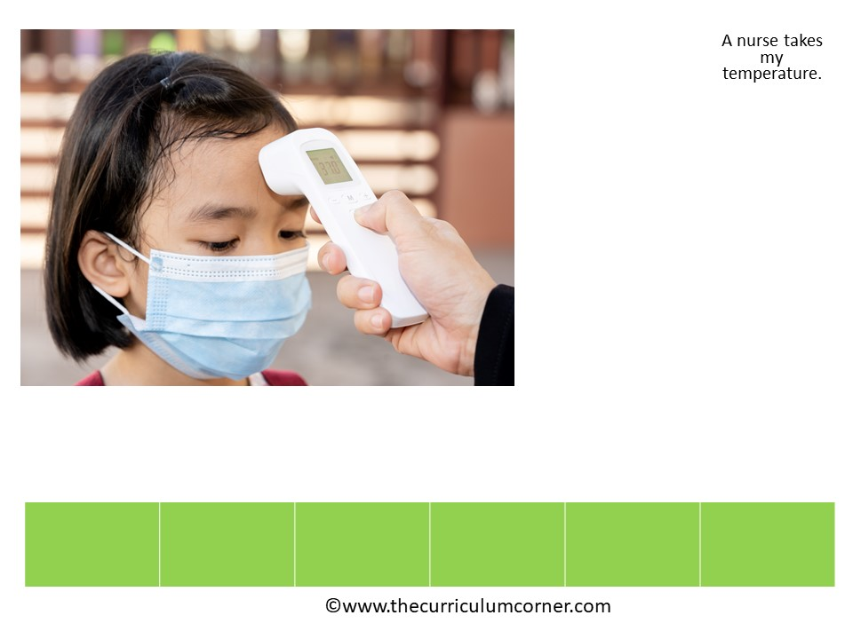
.
nurse
temperature
my
takes
A

Slide 7
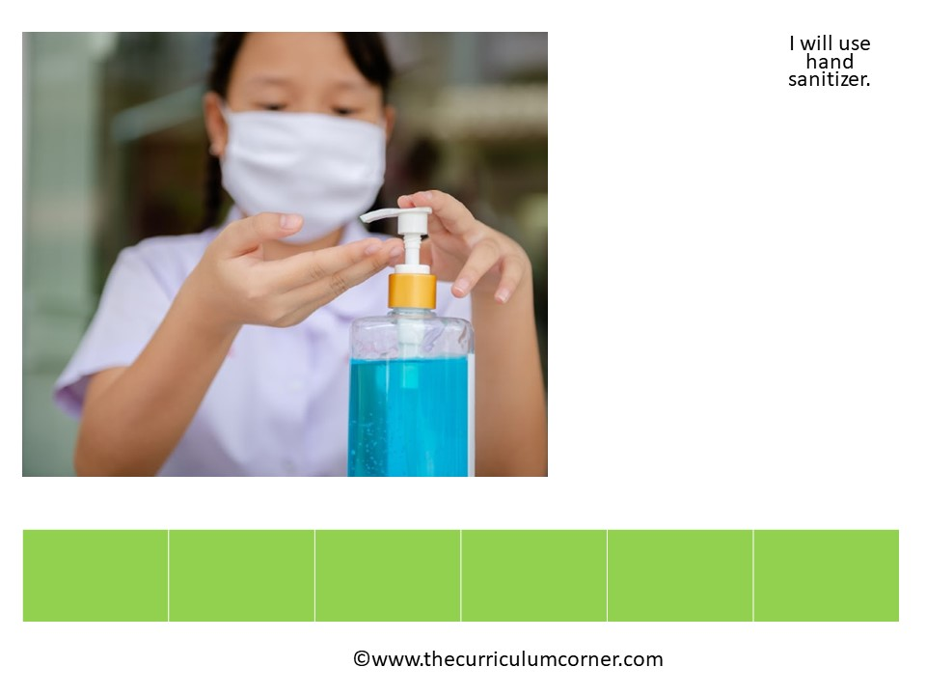
.
use
sanitizer
will
hand
I

Slide 8

.
home
Somedays
at
I
learn

Slide 9
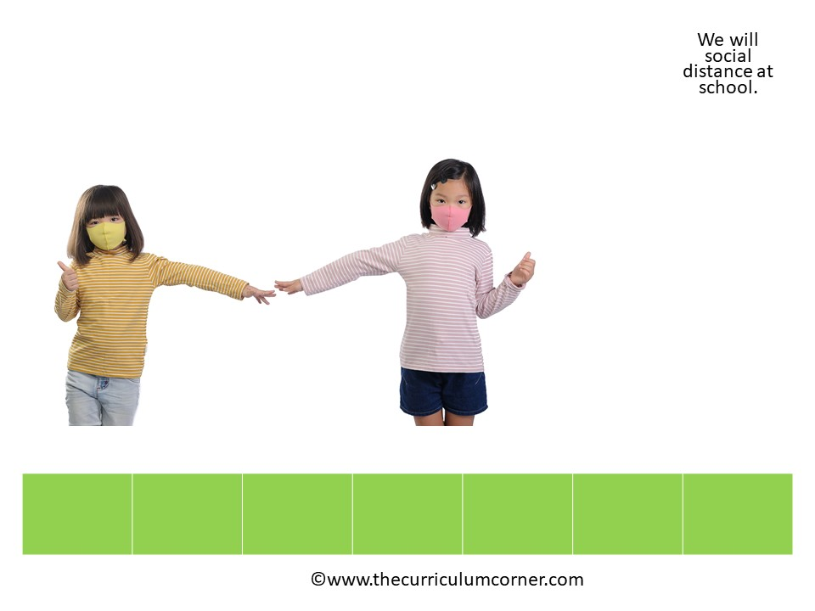
.
social
We
will
distance
at
school

Slide 10

.
I
feel
sick

